Slide 1
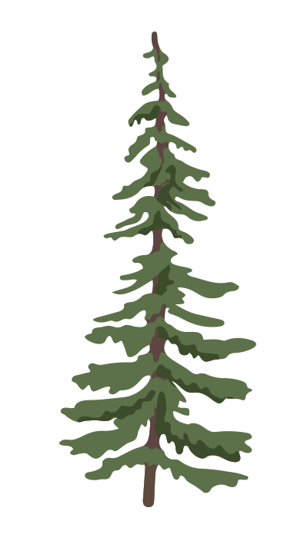


Differences in water uptake strategies of Pinus sylvestris and Pseudotsuga menziesii
Was it enough time to find the isotopic label? -
Ecohydrology 2026
13.03.2026
Johanna Trost, Marie Holzmüller, Sarah Heinrich, Vincent Nilson
Notes:
Folien:
Marie: 1-4, 23-25
Sarah: 5, 8-15
Vincent + Jojo Label, 7, 26 +27

Slide 2
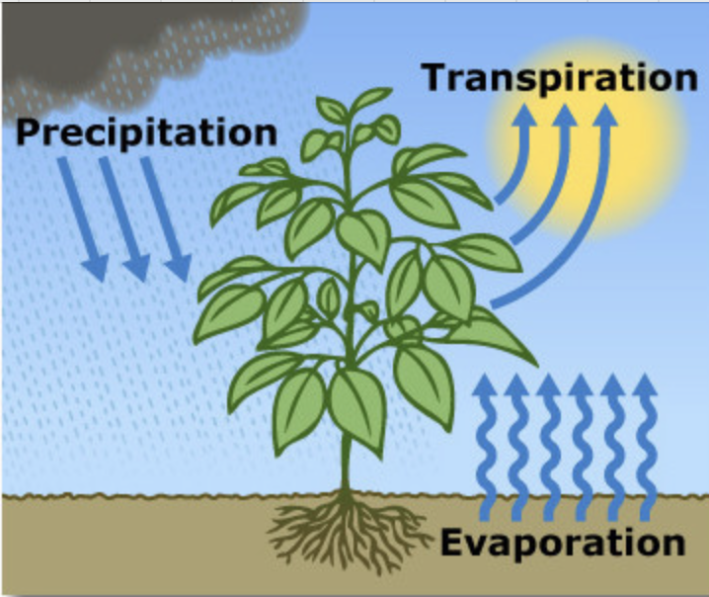
Introduction
Transpiration dominates evapotranspiration
globally (Jascheko et al. 2013)
Research aim at better understanding water
uptake and spending across different species
Different water uptake strategies affect drought
resilience, competition and water availability in
ecosystems (Haberstroh & Werner 2022)
Water transport is mostly studied using sap flow measurements, but also stable isotope analysis provides insights into transport rates (Werner et al. 2021)
U.S. Geological Survey
Notes:
is a relevant component in the water cycle
only component that is actively regulated via plants

Slide 3
Research focus and hypotheses
Drivers of physiological processes of tree saplings
In the context of favorable environmental conditions we expect a pronounced diurnal course of plant activity and transpiration.
Differences in water uptake strategies of Pinus sylvestris and Pseudotsuga menziesii
Scots pine has a more conservative water use strategy, while Douglas fir is comparably more water spending (Thomas et al. 2022).
→ We expect lower water potentials, higher sap flow and faster uptake of isotopic label in Douglas fir
Comparison of continuous sap flow measurements with stable isotope labelling at different tree heights
→ We expect the sap velocity of individual trees to align with the transport velocity of the water stable isotope label
Notes:
(sufficient soil water availability, increasing temperatures and light intensities)
The sap velocity of individual trees corresponds to the uptake and transport velocity of the water stable isotope label
Thomas et al. 2022: Douglas fir reaches lower water potential values compared to scots pine, lower PLC50

Slide 4
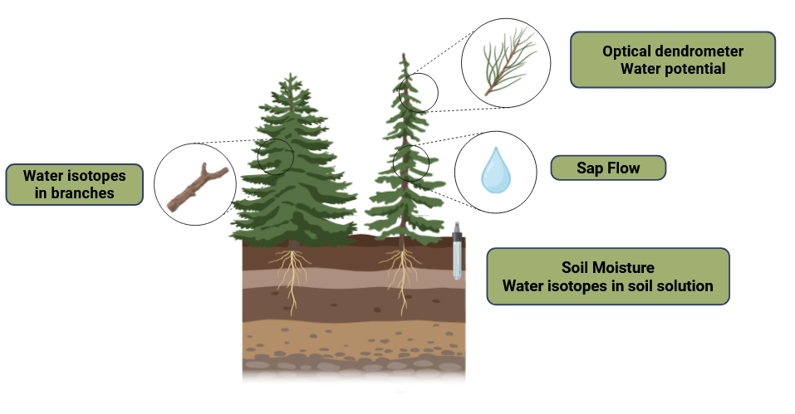
Experimental design
3 Scots pine & 3 Douglas fir
Continuous measurements
Sap flow
Optical dendrometer
Soil moisture
Environmental data
Notes:
Continuous measurements:
Sap flow
Optical dendrometer
Soil moisture
Environmental data
Water Potential:
on 3 consecutive days, measured with a Scholander pressure bomb
bagging shoot >1h before measurement with aluminium foil, allows equilibration with stem
measurements of 25th of February were excluded due to foggy conditions
Optical dendrometers:
measured continuously, identifying branch area with repeated photographs
used as a proxy for continuous water potential

Slide 5
Experimental design
3 Scots pine & 3 Douglas fir
Water stable isotope labelling
Deuterium enriched water: + 6000 ‰
1 litre applied to the soil of each sapling
Before label application: samples of water isotopes in soil solution & puddle (proxy for precipitation)
Measurement campaign (3 days)
Water isotopes in branches
  Low: ~ 40 cm
  Mid: ~ 100 cm
  High: ~ 150 cm
Water potential
  Measured with Scholander pressure bomb
  Shoots were bagged >1h before measurement with aluminium foil
  Exclusion of first measurement day in analysis due to fog
Notes:
water potential: shoots were bagged to stop transpiration and allow the leaf water potential to equilibrate with the stem water potential

Slide 6
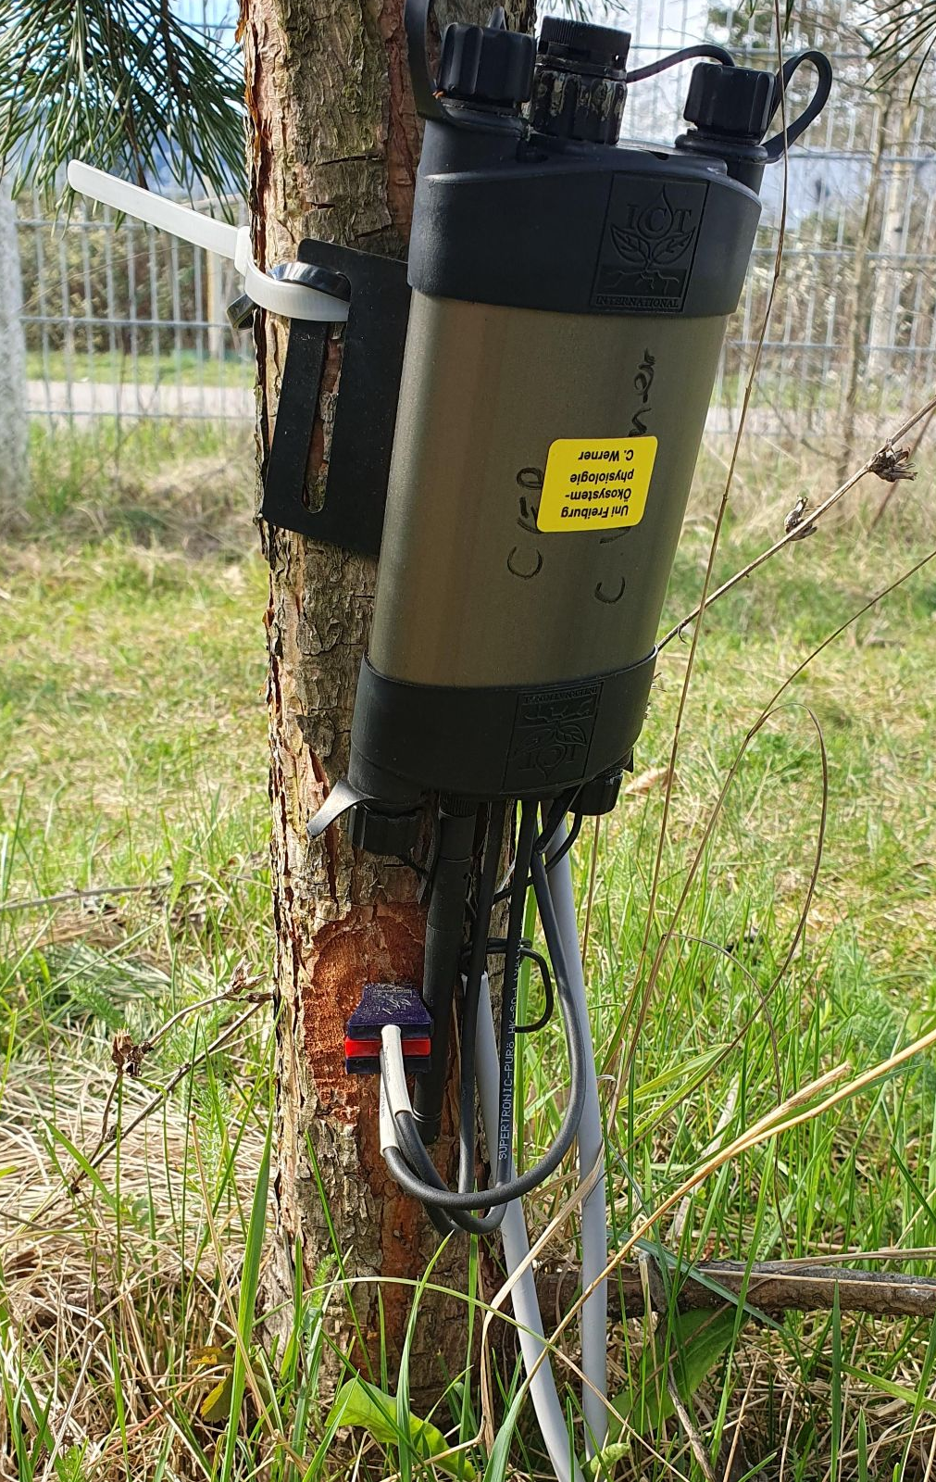
Methods
Sap flow:
Heat Ratio Method (SFM1 sensors)
Heat velocity was converted to sap velocity (cm hour⁻¹) and total sap flow (cm³ h⁻¹) following equations provided in SFM1 manual
Sap wood area estimated based on diameter of individual trees

Slide 7
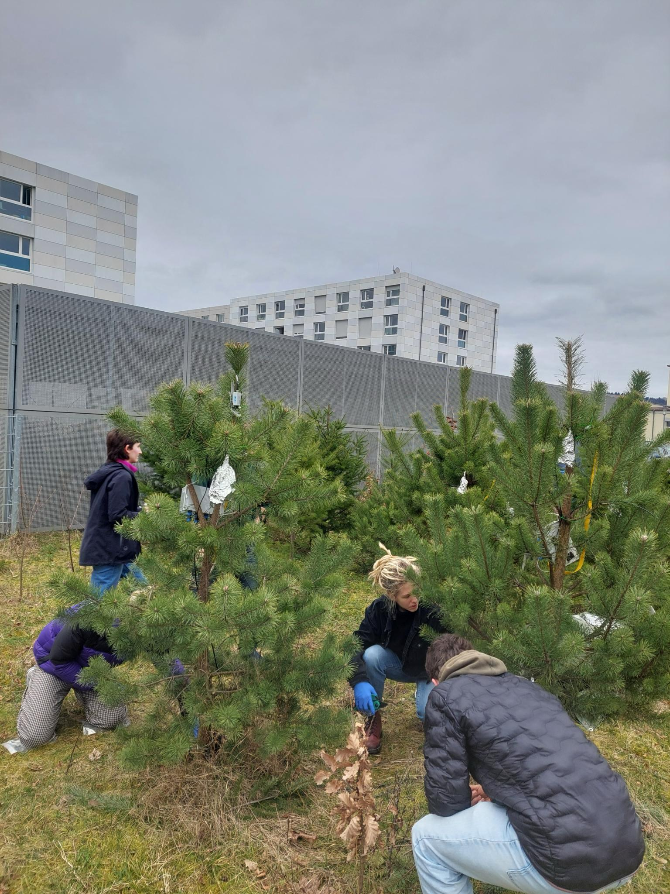
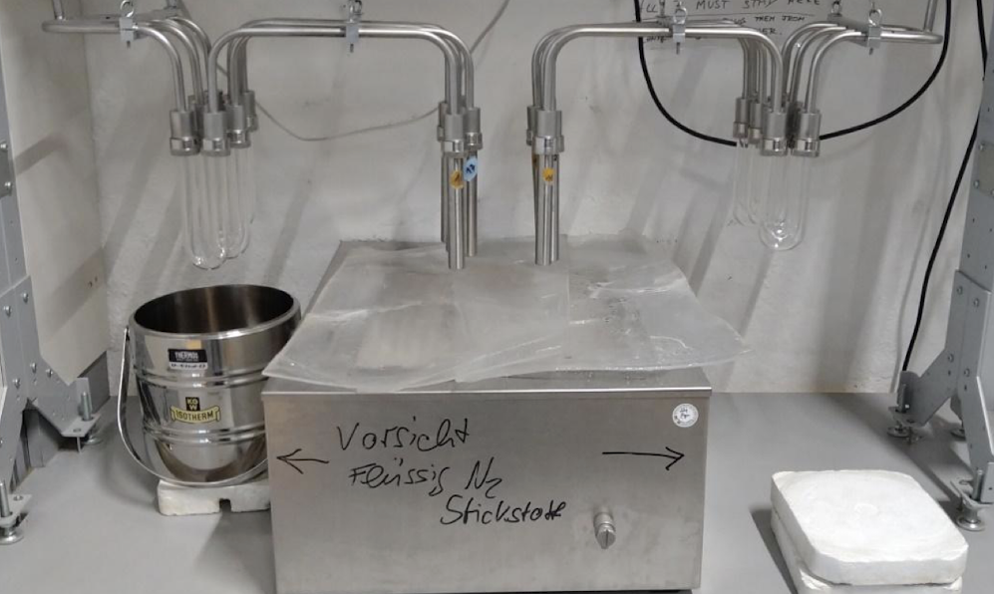
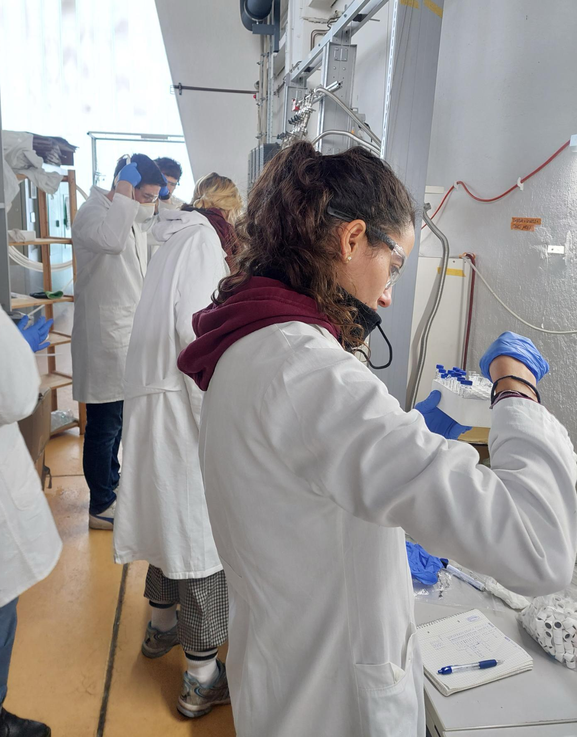
Methods
Isotope labelling experiment:
Cryogenic vacuum extraction: water from the samples evaporates and freezes over cold trap
Laser spectroscopy (Picarro)

Slide 8
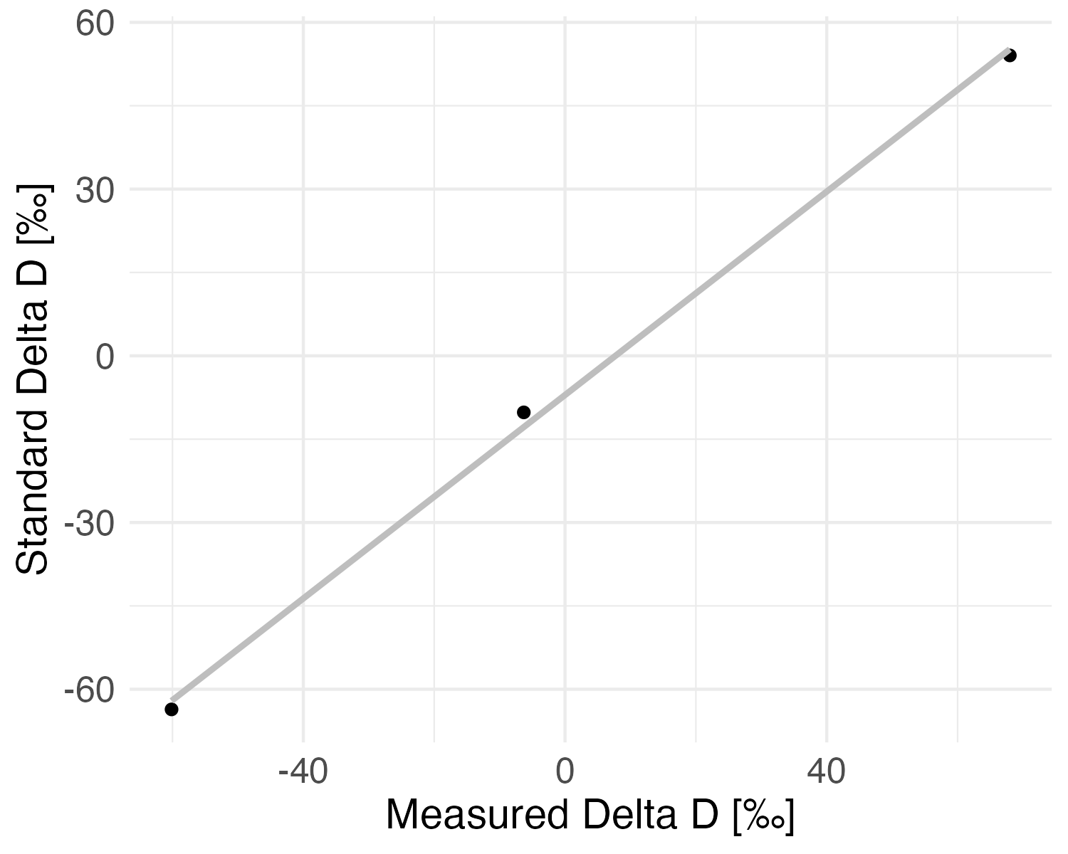
Methods
Processing isotope measurements
Calibration
  true 2H = 0.92(measured 2H) - 7.06
  true 18O ~ 0.97(measured 18O) + 0.33
Notes:
To analyse the stable isotope signatures we first had to process the raw data
As a first step we calibrated the data. for this we fitted the measurements of our enriched water standards to the ground truth isotopic signatures using a lm

Slide 9
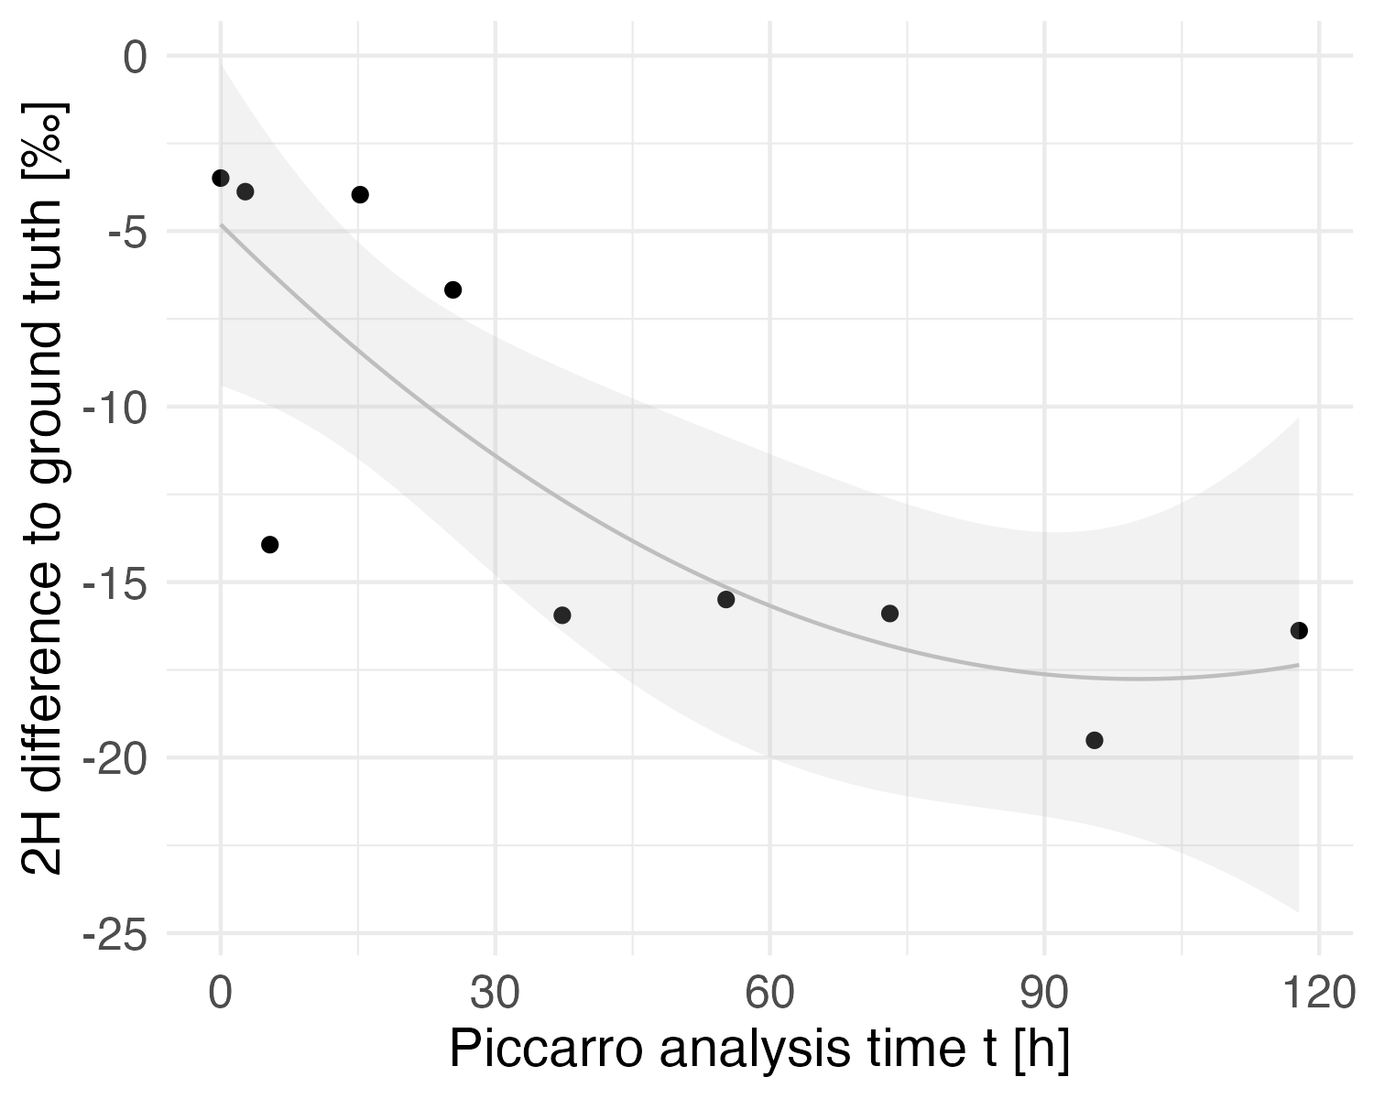
Methods
Processing isotope measurements
Calibration
  true 2H ~ 0.92 (measured 2H) - 7.06
  true 18O ~ 0.97 (measured 18O) + 0.33
Drift correction
  2H diff. ~ -0.26t + 0.002t² - 4.80
  18O diff. ~ -0.12t + 0.0005t² -1.08
Notes:
We then saw that the Picarro produced a shift in Deuterium and 18O. This means that over time the difference between the ground truth standard deuterium and the measurements increases. We corrected this shift using again a liniar model to estimate the shift based on the time

Slide 10
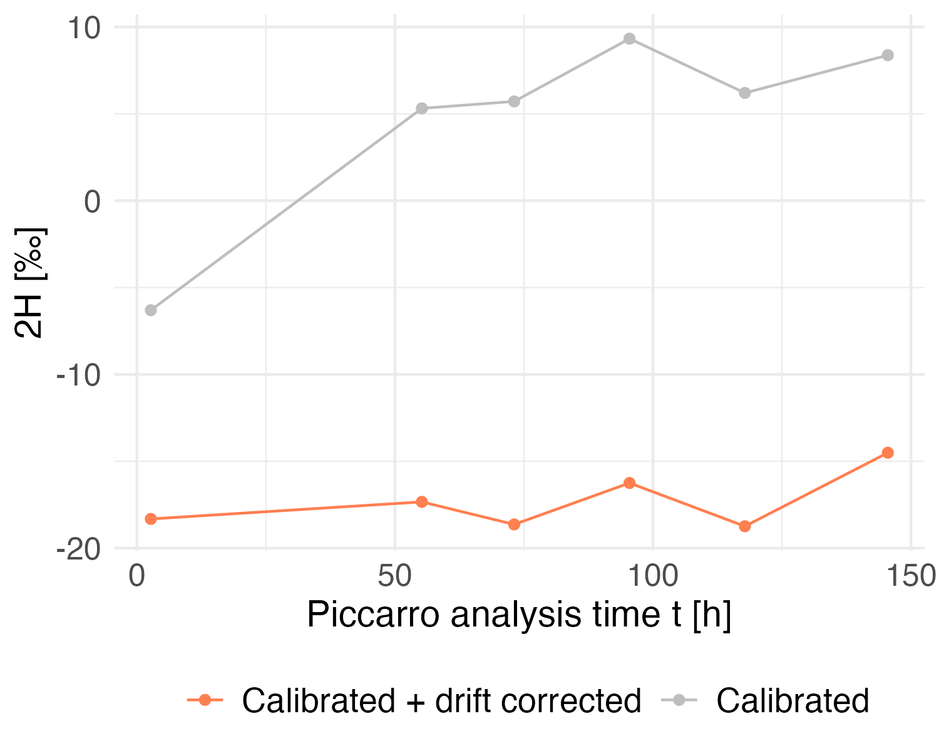
Methods
Processing isotope measurements
Calibration
  true 2H ~ 0.92 (measured 2H) - 7.06
  true 18O ~ 0.97 (measured 18O) + 0.33
Drift correction
  2H diff. ~ -0.26t + 0.002t² - 4.80
  18O diff. ~ -0.12t + 0.0005t² -1.08
Calibration + Drift
Standard (heavy: -10.18‰)
Notes:
By then adding the predicted shift to the calibrated deuterium we could detrend our data. Here we see for example the standard heavy where the orange line shows the drift corrected measurements that are relatively stable values over time in comparison to the uncorrected data that increases in the beginning
In the measurements we saw an odd jump on the second day of measurements that we could not fix with this correction which is why we excluded that day from our results.

Slide 11

Methods
Estimating source contribution with mixing models
MixSIAR (Bayesian) Stock, Brian, et al. (2018)
One model per day and species:
sources (soil, precipitation, label) → mixture (2H, 18O of trees/height)
Mixing Equation Kühnhammer et al. (2023)
Simple mixing equation using label and soil isotope signatures as sources for calculating the fraction of isotopic contribution:
Notes:
With these processed isotopic values we could now estimate the source contribution from the soil precipitation and label using mixing models. We first applied a Bayesian approach, MixSIAR where we fitted one model for each day and species. This gives us the proportional contribution of the different sources to the mixture of Deuterium and 18O. As fixed effects we defined the tree individuals and different height levels
Additionally we used a more simplistic mixing equation following the approach of Kühnhammer et al.
In this mixing equation only the label and the soil water are assumed for sap flow contribution.

Slide 12
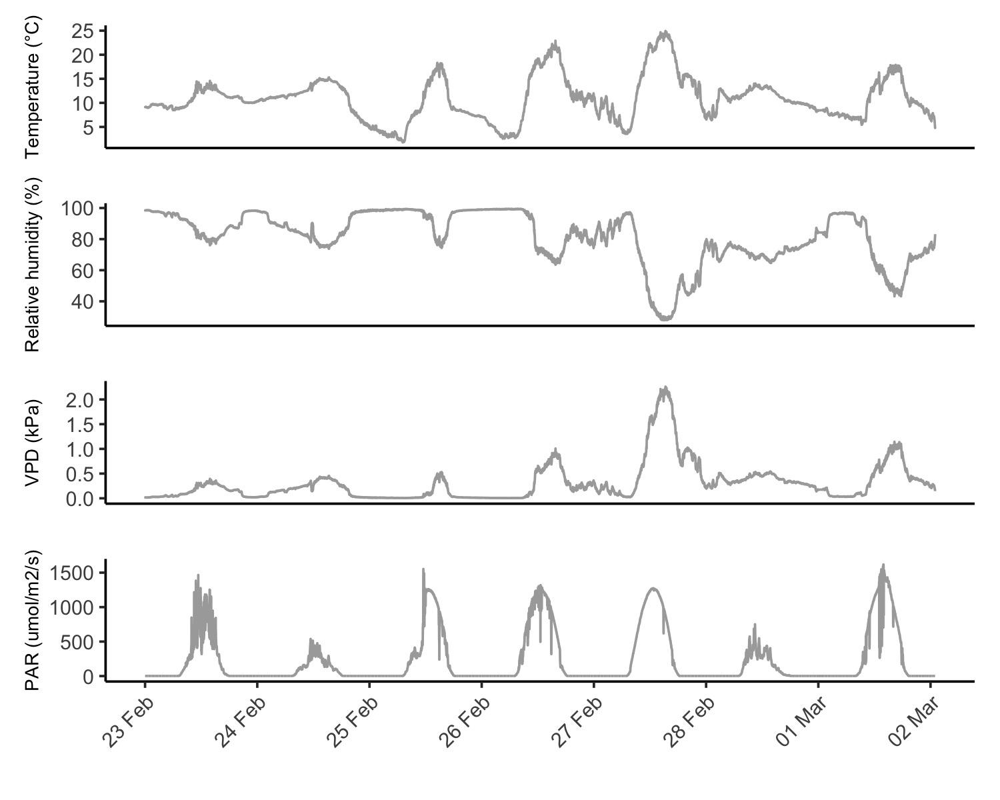
Meteorological conditions during the experiment
Measurement campaign
Label
Measurement campaign:
Water potential
Stable isotopes
Notes:
Temp, VPD, Par, RH, Soil moisture
-> in Grafik zeigen wann welche Messungen etc.
Mean von allen Bäumen soil moisture dazu plotten

Slide 13
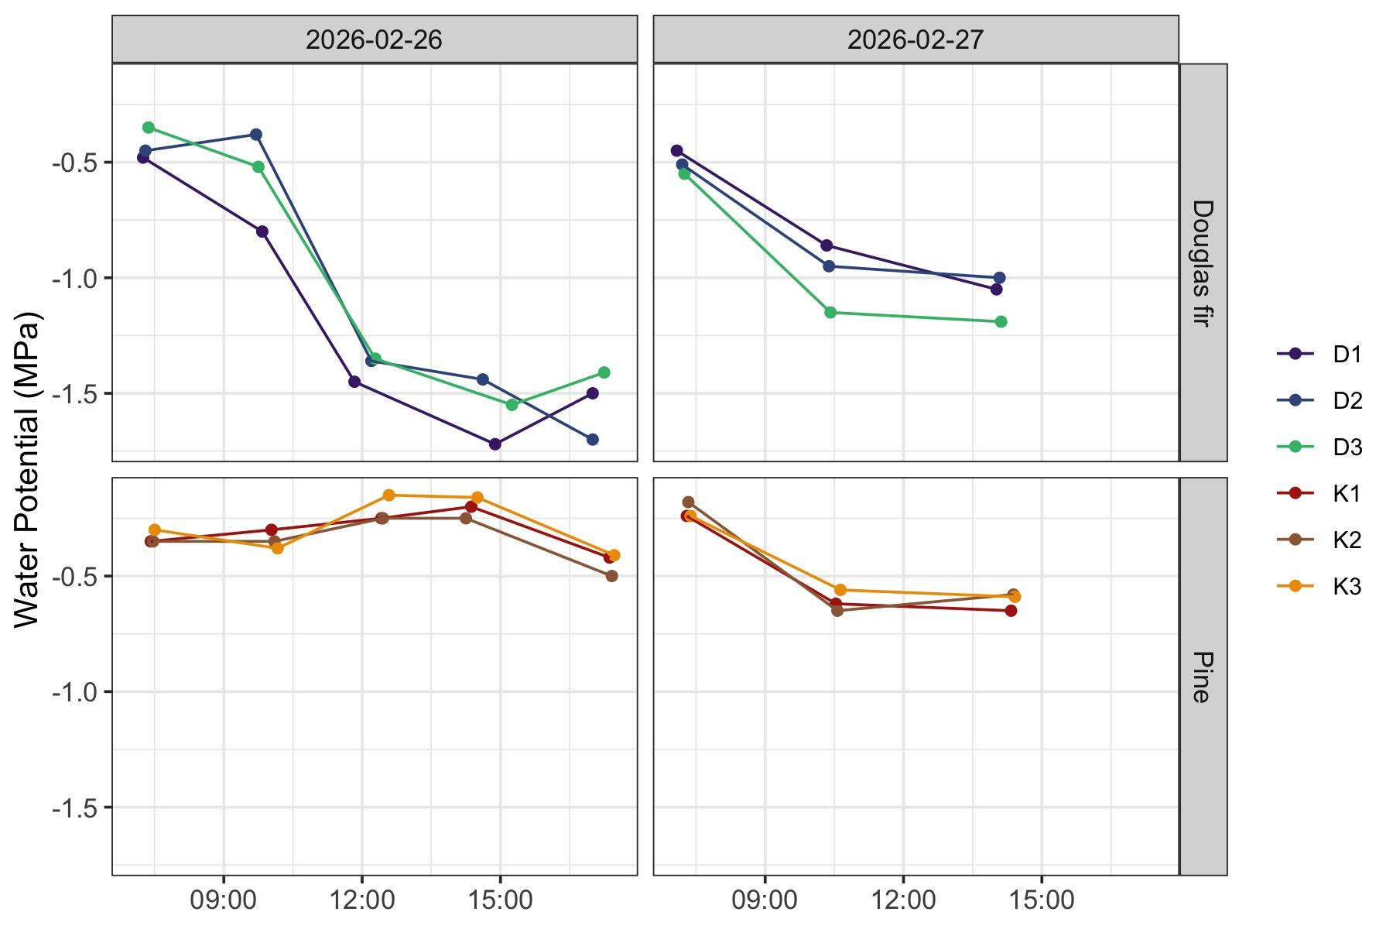

Results - Water potential
Measurements on shoots without active transpiration
Douglas fir can allow lower Water Potential before losing conductivity compared to Scots Pine (Thomas et al. 2022)
Notes:
Thomas et al. (2022) Douglas fir is observed to have lower Water Potnential compared to Scots pine, as low as -2.9 MPa in Douglas fir and -2.6 MPa in Scots Pine, in mature trees, Douglas fir can reach very low values of Water Potential before loosing a lot of conductivity (PLC50 -3.8 - -5.4 MPa)
Douglas fir lower water potentials
Douglas fir water potential decreases midday due to high VPD, not in pine on 26.2., maybe bc conditions are good, enough soil moisture, pine keeps constant water flow, while douglas fir water flow too high, water is transpired faster than it is transported

Slide 14
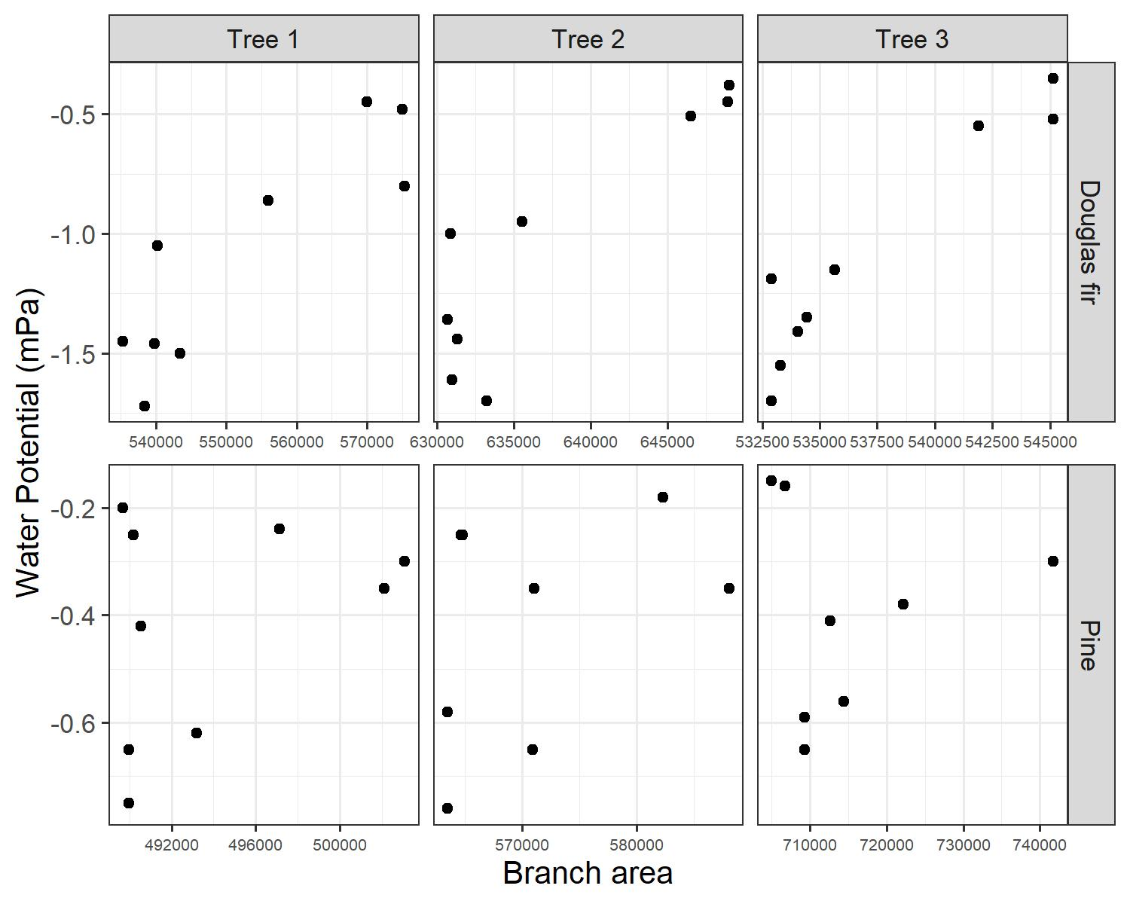
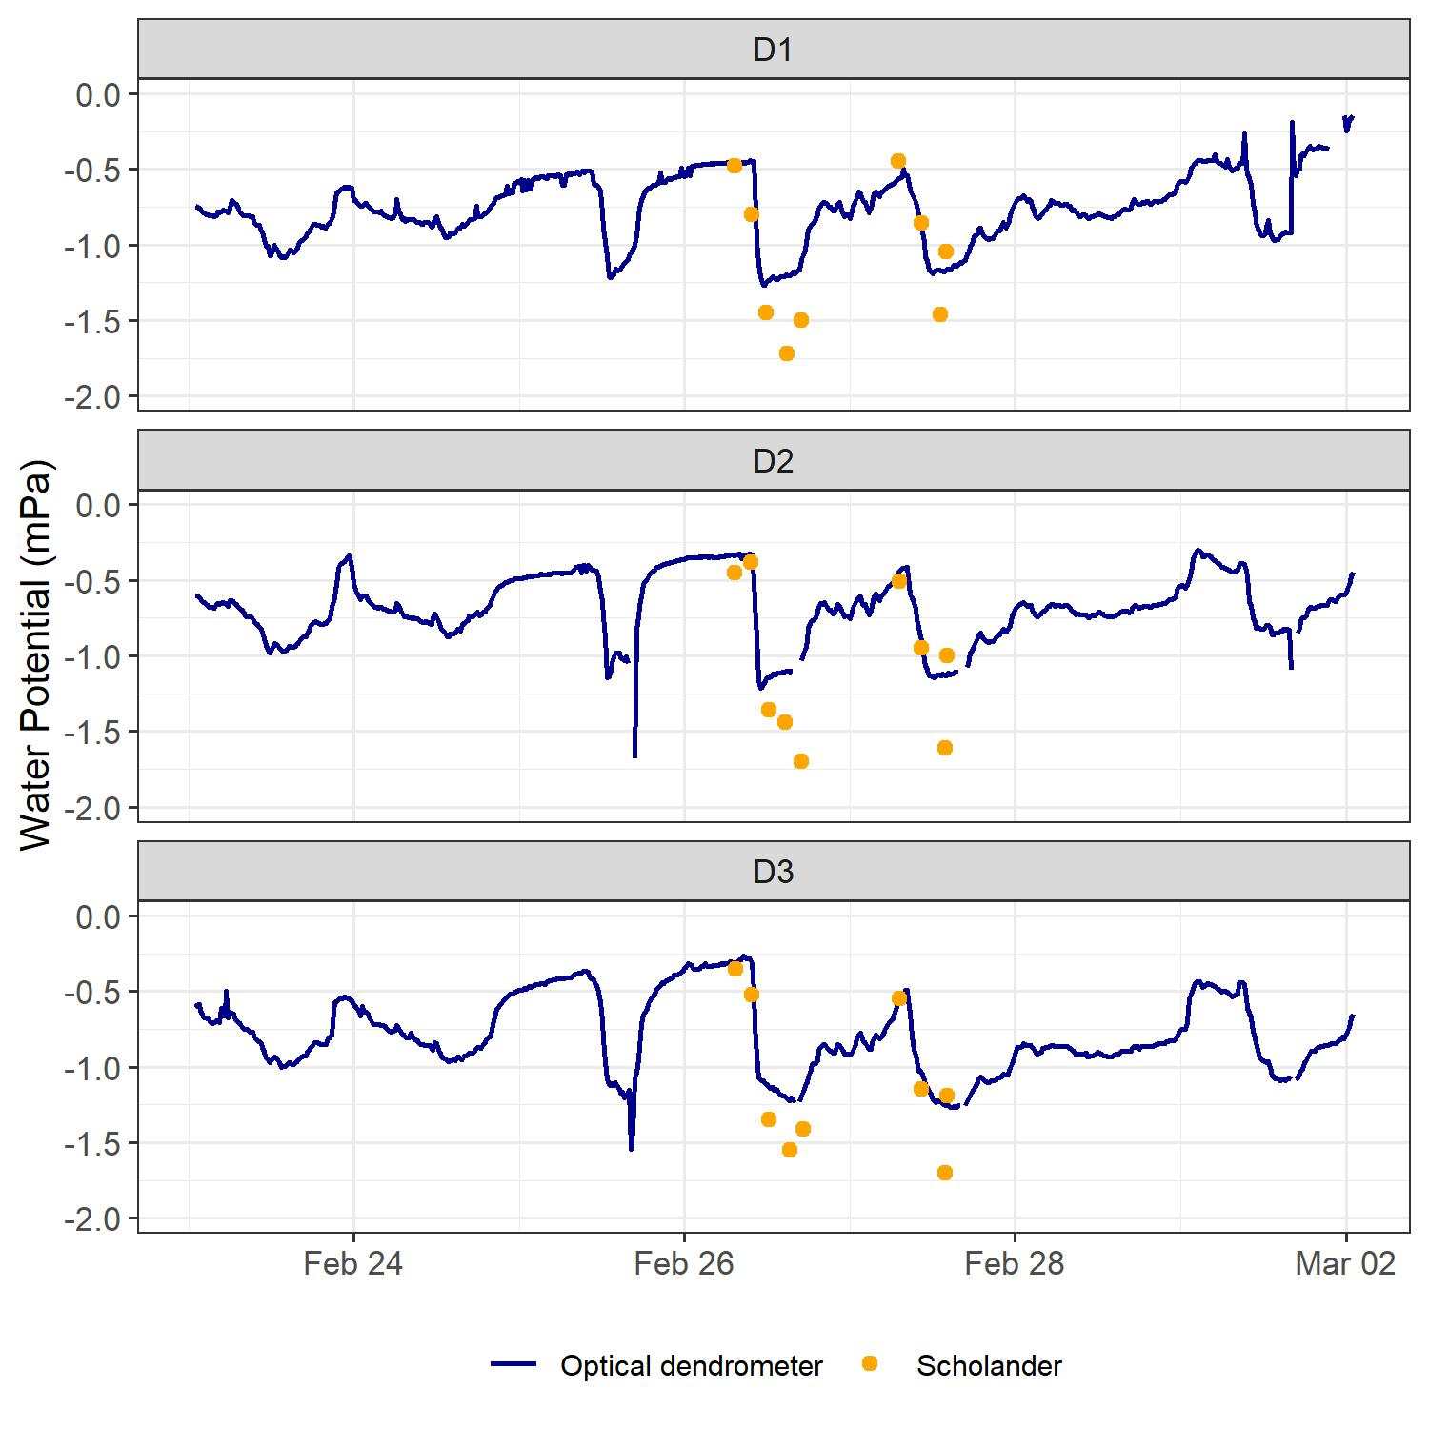
Results - Water Potential using optical dendrometers
Bourbia & Brodribb 2023
Notes:
Bourbia & Brodribb showed that optical dendrometry can be used to continuously monitor plant water status
lm: WP ~ area * ID
Adj R squared: 0.34
Dharma package: no significant issues detected, but also not very good diagnostics

Slide 15
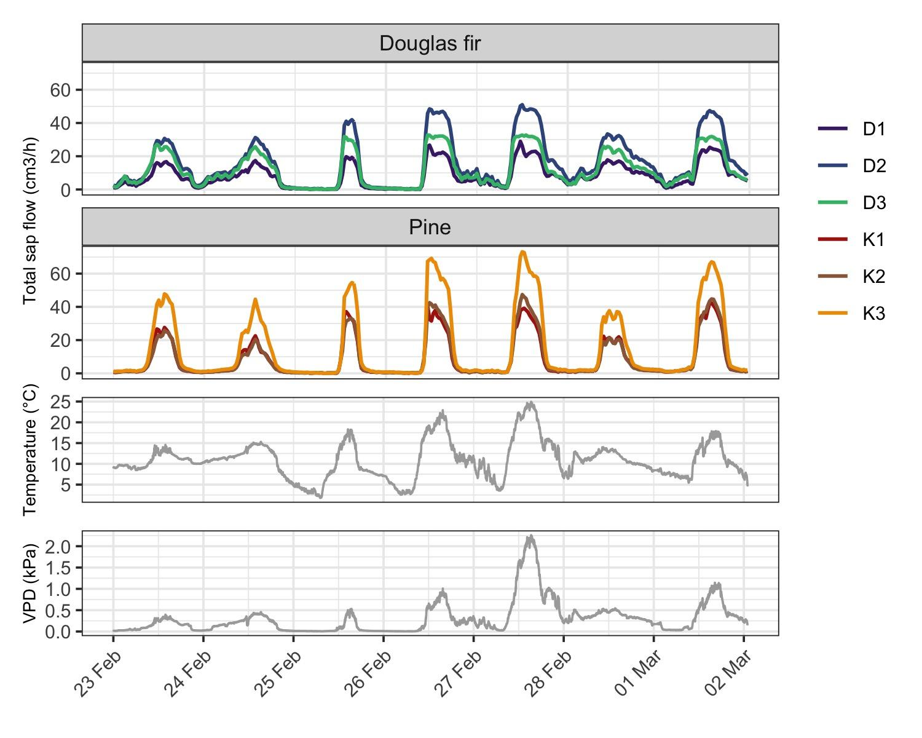
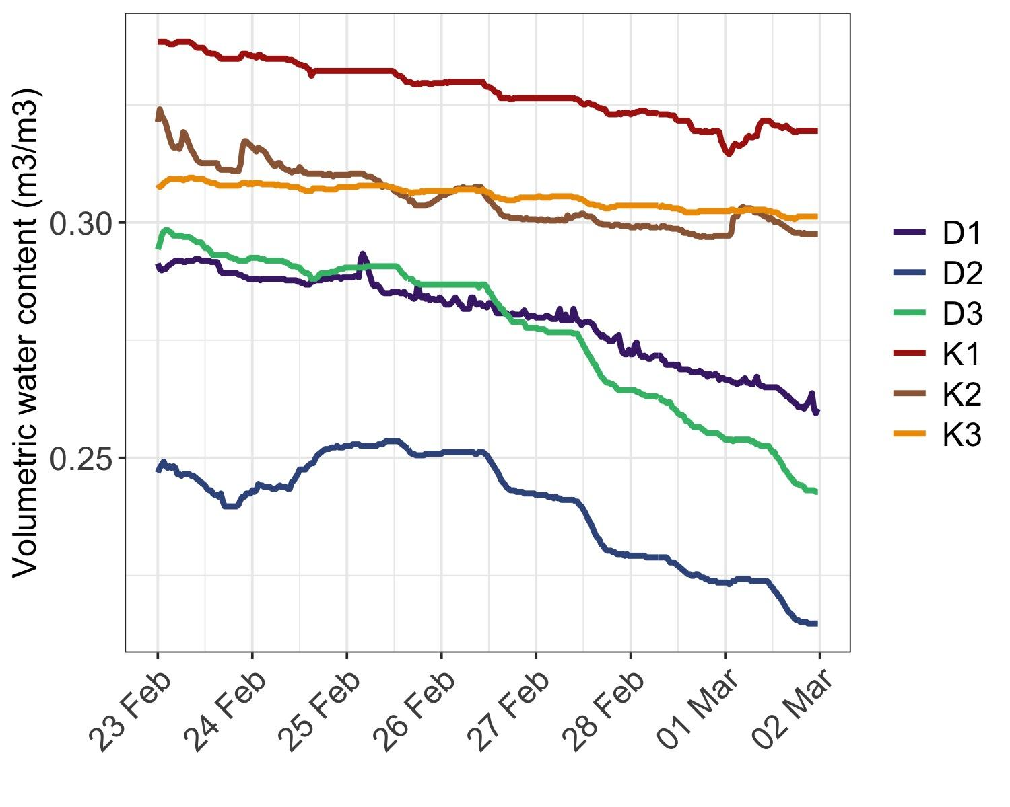
Results - Sap flow
Sap wood area (cm²) | Pine | Douglas fir
1 | 18.10 | 17.35
2 | 16.62 | 31.17
3 | 20.43 | 20.43
Notes:
Pine slightly higher sap flow
Differences between individual trees from one species are largely explained by different sap wood areas
In first few nights VPD goes down to zero, not on the 26th, 27th, not entirely on the 28th -> causing sap flow at night in douglas fir but not in pine (could show refilling of sap wood with water)
Dawson et al. 2007
continued flux of water into plants at night in 20 tree species
Nighttime water flux in stems and leaves occurs because leaf water potential declines over the course of daytime transpiration to the point that, when transpiration ceases, a water potential gradient between leaf and soil remains (Hinckley 1971). This water potential gradient drives water movement that can be detected by sap flow sensors
Cause: refilling of partially depleted xylem water stores or transpiration (We detected nighttime transpiration or nighttime stomatal conductance in trees and values were highest in plants from sites with higher soil water contents)
Sap flow increasing on warm and sunny days, VPD peak on 27th of Feb, influence on sap flow seems minor (similar to other days)

Slide 16

Hypothesis 1
In the context of favorable environmental conditions we expect a pronounced diurnal course of plant activity and transpiration.
→ yes! but: Water potential no clear diurnal course in Pine trees

Slide 17
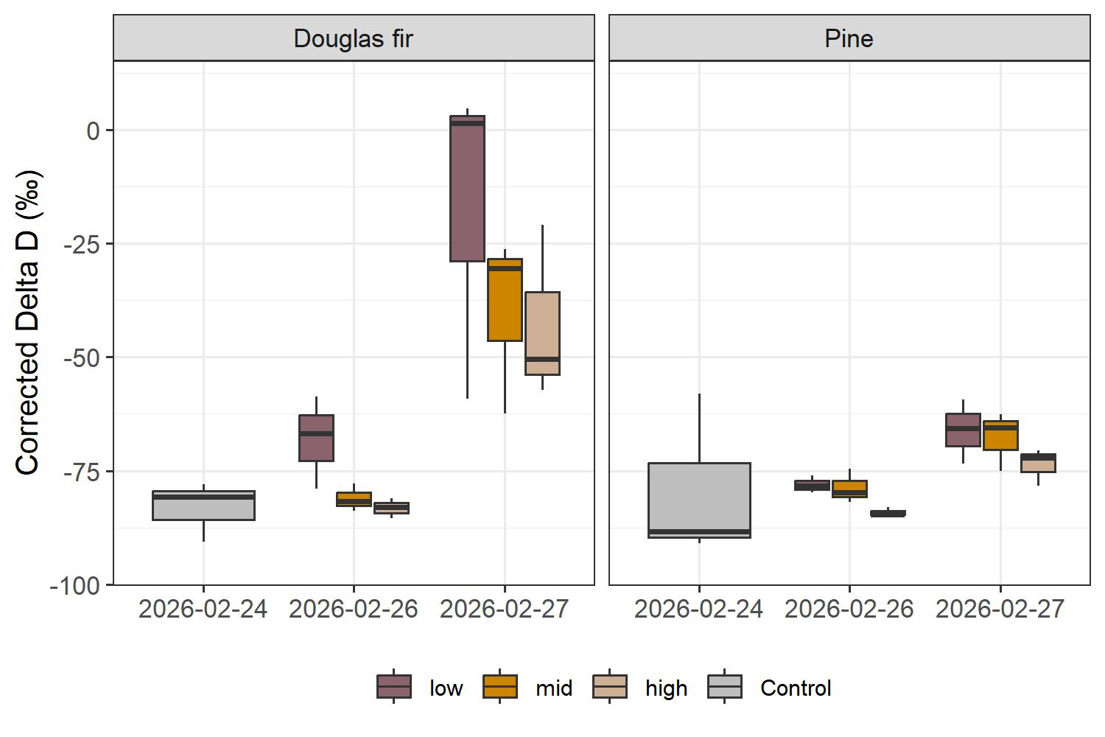
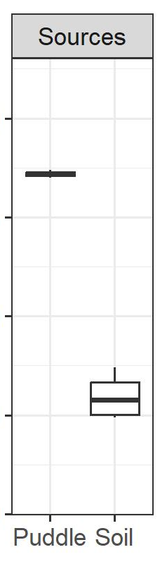
Results - Label detection
?
?
?
?
Low ~ 40 cm
Mid ~ 100 cm
High ~ 150 cm
pre-labeled
Notes:
dual isotope plot
now we come to the question if we found the label in our samples
control -> isotopic signature before labeling

Slide 18
Results - Label detection
?
?
Low ~ 40 cm
Mid ~ 100 cm
High ~ 150 cm
pre-labeled
Notes:
dual isotope plot

Slide 19
Results - Label detection
Low ~ 40 cm
Mid ~ 100 cm
High ~ 150 cm
pre-labeled
Notes:
dual isotope plot
label + 6000 noch auf die folie
for scots pine relatively small increase in deuterium signature -> stay in the range of pre labeled signiture

Slide 20
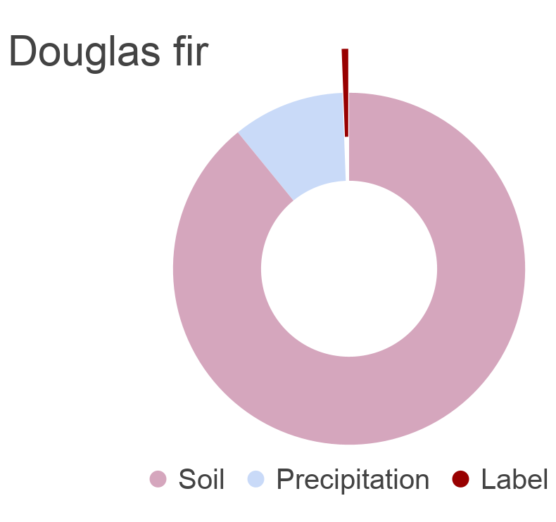
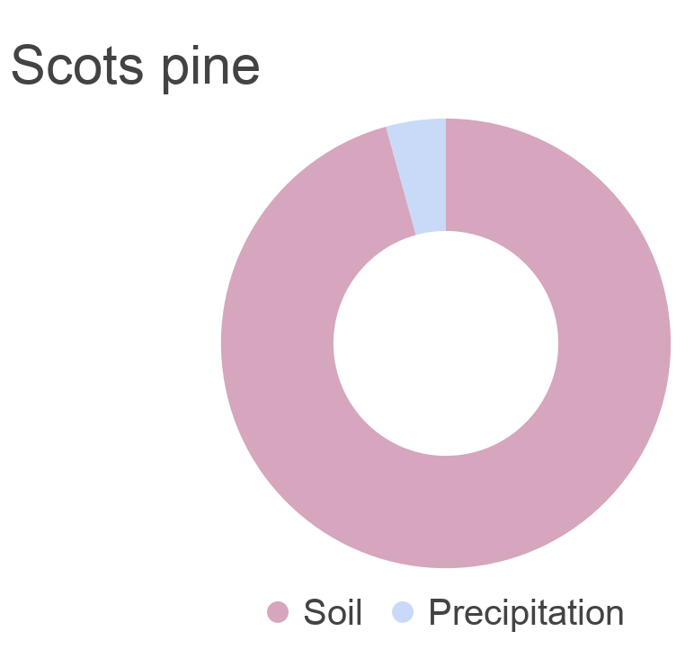
Results - Source contribution (MixSIAR)
Average contribution (2026-02-27)
0.6%
4.3%
10.4%
89.2%
95.7%
Notes:
From this data we can now statistically estimate the actual source contributions to the water mixture on that critical last day of measurement. According to our MixSIAR model Soil makes up the largest fraction of the water with around 90 - 96% followed by precipitation with 4-10%. Finally we only see a small fraction of on avg 0.6 of label in the Douglas fir and none in scots pine

Slide 21
Results - Source contribution (MixSIAR)
Average contribution (2026-02-27)
Source | Douglas fir | Pine
Soil | 89.2% | 95.7%
Precipitation | 10.4% | 4.3%
Label | 0.6% | 0.0%
Notes:
D2 Verduennungseffect
nur douglas fir am 27., y achse ab 0 %
ml/day erwähnen absolute uptake mit sap flux kombiniert

Slide 22
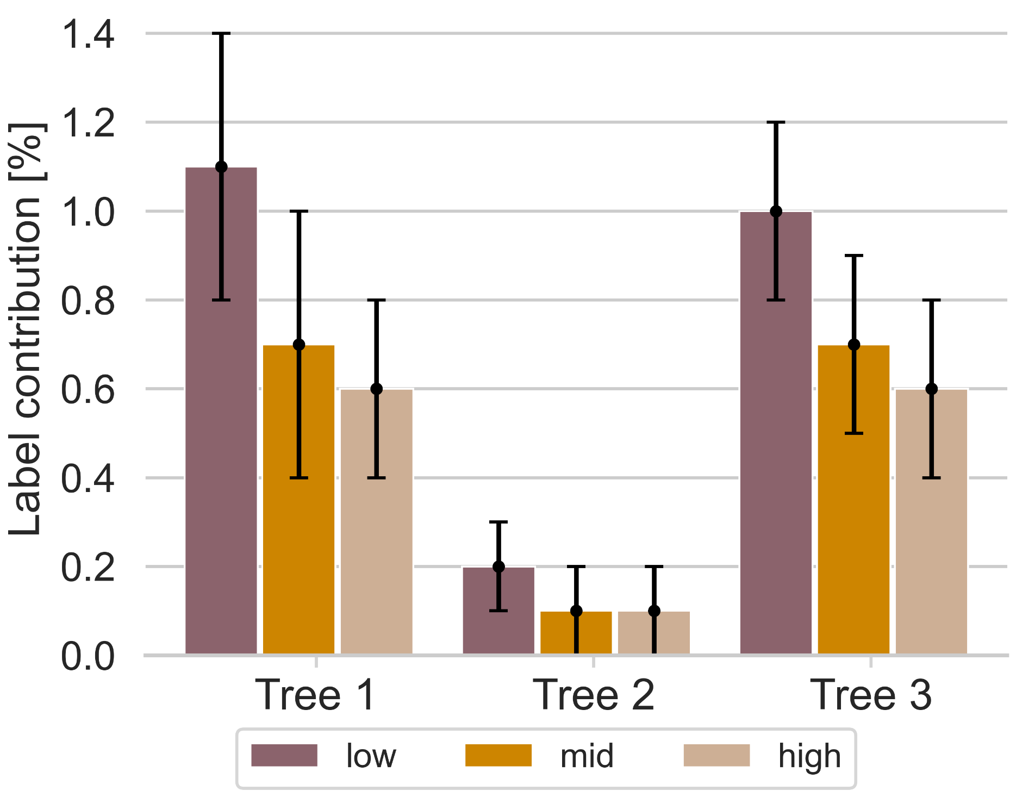
Results - Source contribution (MixSIAR)
Average contribution (2026-02-27)
0.6%
10.4%
89.2%
Notes:
Zooming into the label contribution we can differentiate between the 3 douglas trees and the height level. The pattern here corresponds to the isotopic values, the label contributes most to the lowest level and least to the highest. Notably the second tree deviates from the others but we will come to that later on.
Combining these results with the sap wood area we have a label uptake of up to 5ml/day

Slide 23
Results - Source contribution (MixSIAR)
Average contribution (2026-02-27)
0.6%
10.4%
89.2%
Total label uptake of up to 5 ml/day
Notes:
Zooming into the label contribution we can differentiate between the 3 douglas trees and the height level. The pattern here corresponds to the isotopic values, the label contributes most to the lowest level and least to the highest. Notably the second tree deviates from the others but we will come to that later on.
Combining these results with the sap wood area we have a label uptake of up to 5ml/day

Slide 24
Results - MixSIAR vs. Kuehnhammer
Notes:
Finally we also compared the MixSIAR model to the approach that simpler Kuehnhammer approach. Again we have the percent contribution on the y axis and the different trees on the x-axis. we also look at the 2 days of measurements, here we see douglas fir and here scots pine. The lighter bars show the Kuehnhammer method and the other bars the MixSIAR.
kuehnhammer method is quite on par with the mixsiar method. The mixsiar is almost consistently lower

Slide 25
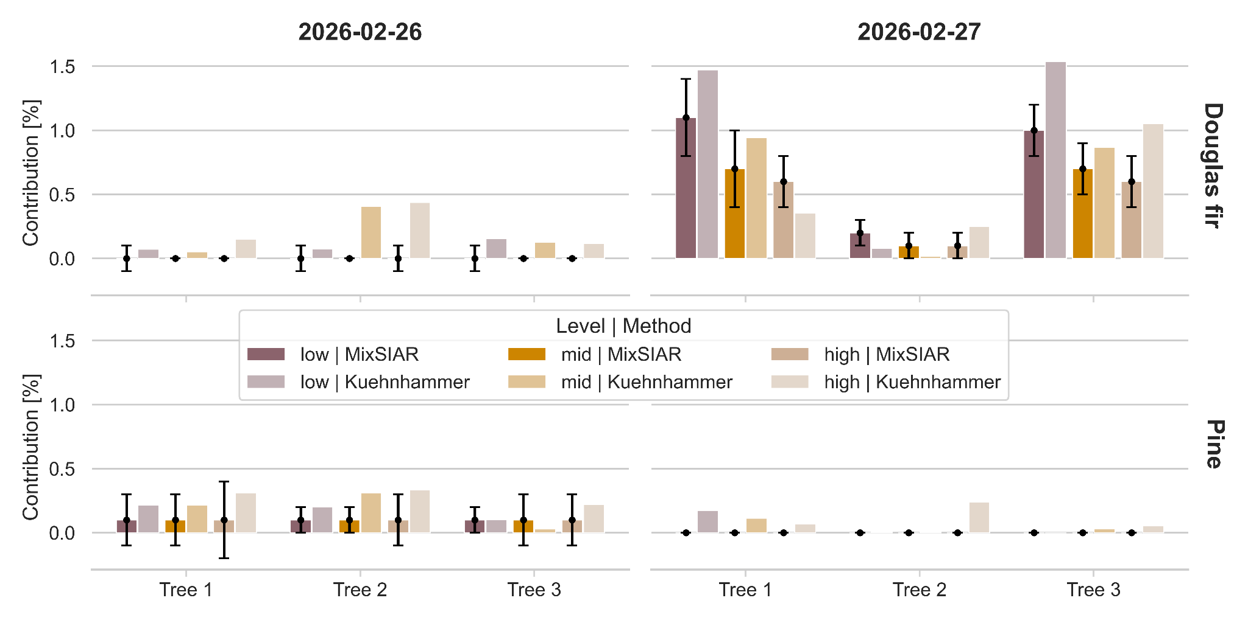
Results - MixSIAR vs. Kuehnhammer
Notes:
Finally we also compared the MixSIAR model to the approach that simpler Kuehnhammer approach. Again we have the percent contribution on the y axis and the different trees on the x-axis. we also look at the 2 days of measurements, here we see douglas fir and here scots pine. The lighter bars show the Kuehnhammer method and the other bars the MixSIAR.
kuehnhammer method is quite on par with the mixsiar method. The mixsiar is almost consistently lower

Slide 26

Hypothesis 2
Scots pine has a more conservative water use strategy, while Douglas fir is comparably more water spending (Thomas et al. 2022).
Douglas fir has
Lower water potentials
Faster uptake of isotopic label
→ Suggesting higher transpiration rates
Also supported by stronger decrease in soil moisture
Higher sap flow
Notes:
Findings:
Water potential drops stronger in Douglas fir
Isotopic signature in Douglas fir indicates that label was taken up faster
Soil moisture measured next to Douglas fir trees decreased stronger throughout sunny days
However: Sap flow indicates comparable water consumption in Douglas fir and Scots pine
issues mit upscaling vom sap flow, kiefer inner and outer sap flow unsicherheit, inner viel weniger sap flow als outer bei Kiefer, bei Douglasie etwa gleich
in Berechnung größere gewichtung für sap flow, weil bäume so klein sind, bei kiefer außen bisschen überschätzt, hochgebiast
variation in the radial profile of sap flux density in Pinus species
Chelcy R. Ford, Mary Anne McGuire, Robert J. Mitchell, Robert O. Teskey, Assessing variation in the radial profile of sap flux density in Pinus species and its effect on daily water use, Tree Physiology, Volume 24, Issue 3, March 2004, Pages 241–249, https://doi.org/10.1093/treephys/24.3.241

Slide 27
Hypothesis 2
Scots pine has a more conservative water use strategy, while Douglas fir is comparably more water spending (Thomas et al. 2022).
Douglas fir has
Lower water potentials
Faster uptake of isotopic label
→ Suggesting higher transpiration rates
Also supported by stronger decrease in soil moisture
Higher sap flow
Hypothesis 2 can be partially accepted.
Sap flow does not align with the results of water potential and isotopic label detection.
Possible explanation:
Our data shows high radial variation of sap velocity in pine trees
Also found in the literature (Ford et al. 2007, Nadezhdina et al. 2002)
→ Increased uncertainty of sap flow measurements
Notes:
Findings:
Water potential drops stronger in Douglas fir
Isotopic signature in Douglas fir indicates that label was taken up faster
Soil moisture measured next to Douglas fir trees decreased stronger throughout sunny days
However: Sap flow indicates comparable water consumption in Douglas fir and Scots pine
issues mit upscaling vom sap flow, kiefer inner and outer sap flow unsicherheit, inner viel weniger sap flow als outer bei Kiefer, bei Douglasie etwa gleich
in Berechnung größere gewichtung für sap flow, weil bäume so klein sind, bei kiefer außen bisschen überschätzt, hochgebiast
variation in the radial profile of sap flux density in Pinus species
Chelcy R. Ford, Mary Anne McGuire, Robert J. Mitchell, Robert O. Teskey, Assessing variation in the radial profile of sap flux density in Pinus species and its effect on daily water use, Tree Physiology, Volume 24, Issue 3, March 2004, Pages 241–249, https://doi.org/10.1093/treephys/24.3.241

Slide 28
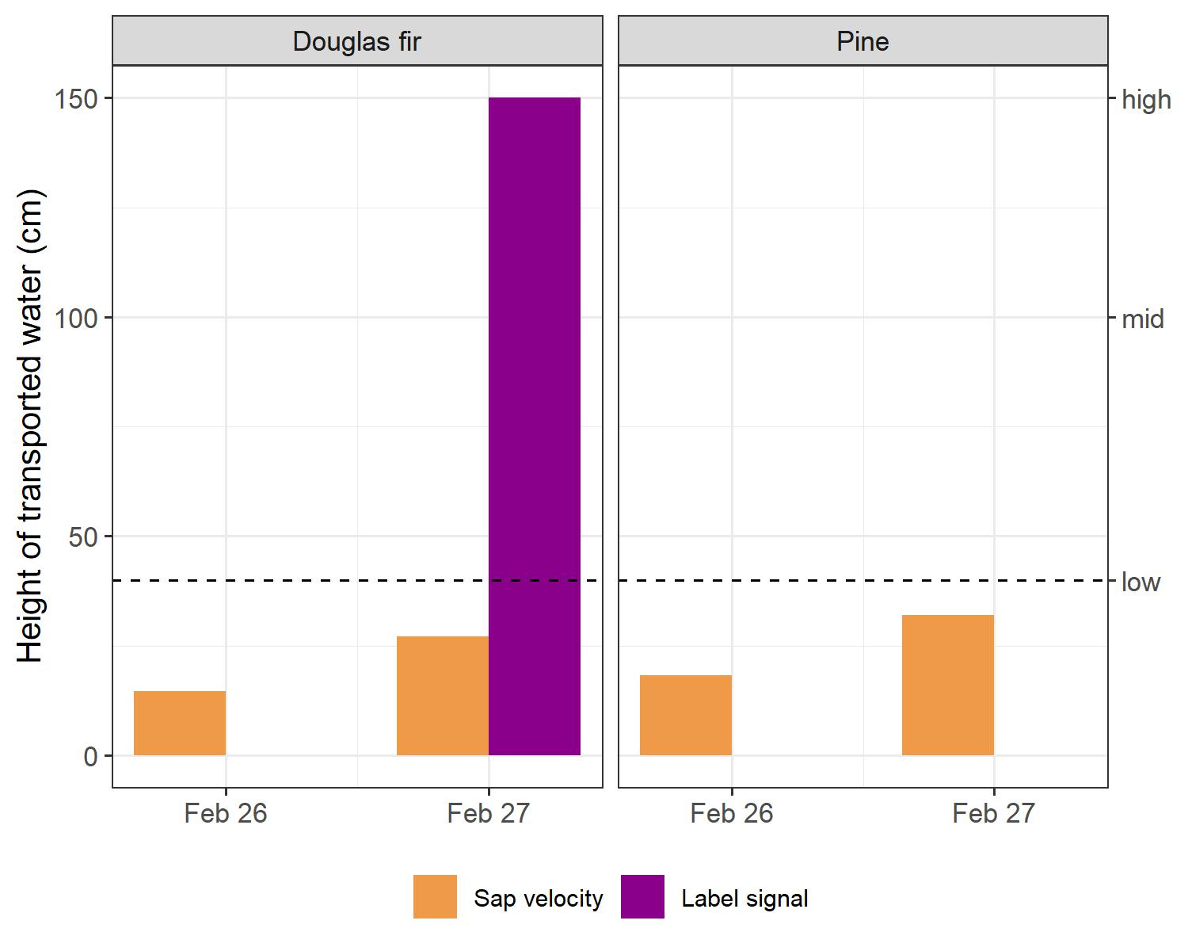
Linkage of sap flow and water stable isotopes
Hypothesis 3
Sap velocity of individual trees corresponds to uptake of water stable isotope label.
→ Partly true
Label signal threshold following Kühnhammer et al. (2023):
mean(pre-label) + 3* sd(pre-label)
Notes:
Sap velocity and label signal suggest label did not reach the low measuring height in Pine (26th and 27th) and in Douglas fir (26th)
However on the 27th we found isotopic label way above the height of water transport based on sap velocity in Douglas fir → possibly underestimation of sap flow
Comparison of continuous sap flow measurements and stable isotope labelling at different tree heights?
The results of the sap velocity do not support the results from the water stable isotope labelling
Sap velocity indicates that water was only transported up to maximum 30cm per day, but we also found label in mid and high branches. High branches taken from 150cm.
first arrival of the tracer signal
in transpired water, defined as the time when δ2
H surpassed the average
pre-labeling value plus three standard deviations (sd).

Slide 29
Limitations
Measurement and processing uncertainties, e.g.:
  Water Potential measured by different people
  Sap flow calculations based on estimated parameters
  Cryogenic vacuum extraction uncertainties (Haberstroh et al., 2024)
  Piccaro drift
MixSIAR: few replicates
Notes:
Difficulty to differentiate between water from xylem and phloem
Sap flow calculations based on estimated parameters instead of measurements -> no tree specific or species specific variations captured
Piccaro drift -> accounted for by drift correction
high isotopic signature of puddles -> precipitation may be too heavy and more difficult to differentiate from label (bifractation?)
cryogenic extraction -> multiple uncertainties like organic contamination and incomplete evaporation
isotope data -> drift

Slide 30
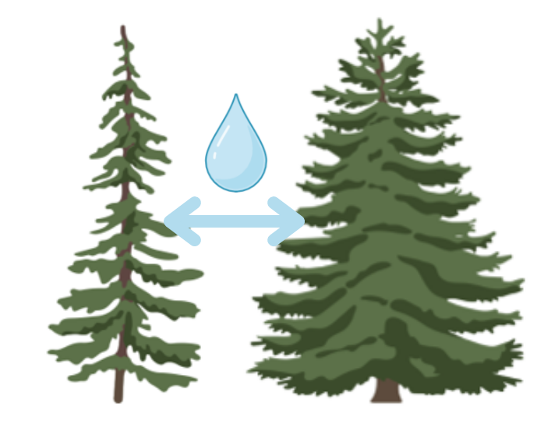


Outlook
Measurements for a few more days
Transition period from winter to spring compared to summer period
Key findings
Onset of favorable weather conditions result in fast eco-
hydrological response
Pronounced differences of water uptake strategies between Douglas fir and Scots pine
Measurement techniques indicate different speed in water transport

Slide 31
References
Bourbia, I., & Brodribb, T. J. (2023). A new technique for monitoring plant transpiration under field conditions using leaf optical dendrometry. Agricultural and Forest Meteorology, 331, 109328.
Ford, C. R., McGuire, M. A., Mitchell, R. J., & Teskey, R. O. (2004). Assessing variation in the radial profile of sap flux density in Pinus species and its effect on daily water use. Tree physiology, 24(3), 241-249.
Haberstroh, S., & Werner, C. (2022). The role of species interactions for forest resilience to drought. Plant Biology, 24(7), 1098-1107.
Haberstroh, S., Kübert, A., & Werner, C. (2024). Two common pitfalls in the analysis of water‐stable isotopologues with cryogenic vacuum extraction and cavity ring‐down spectroscopy. Analytical science advances, 5(3-4), 2300053.
Jasechko, S., Sharp, Z. D., Gibson, J. J., Birks, S. J., Yi, Y., & Fawcett, P. J. (2013). Terrestrial water fluxes dominated by transpiration. Nature, 496(7445), 347-350.
Kühnhammer, K., van Haren, J., Kübert, A., Bailey, K., Dubbert, M., Hu, J., ... & Beyer, M. (2023). Deep roots mitigate drought impacts on tropical trees despite limited quantitative contribution to transpiration. Science of the Total Environment, 893, 164763.
Nadezhdina, N., Čermák, J., & Ceulemans, R. (2002). Radial patterns of sap flow in woody stems of dominant and understory species: scaling errors associated with positioning of sensors. Tree physiology, 22(13), 907-918.
Stock, B., Semmens, B., Ward, E., Parnell, A., Jackson, A., & Phillips, D. (2018). Package ‘MixSIAR’. Bayesian mixing model s in R, Version, 3(10).
Thomas, F. M., Rzepecki, A., & Werner, W. (2021). Non-native Douglas fir (Pseudotsuga menziesii) in Central Europe: ecology, performance and nature conservation. For. Ecol. Manag. 506, 119956.
Werner, C., Meredith, L. K., Ladd, S. N., Ingrisch, J., Kübert, A., Van Haren, J., ... & Williams, J. (2021). Ecosystem fluxes during drought and recovery in an experimental forest. Science, 374(6574), 1514-1518.
U.S. Geological Survey: Evapotranspiration is the sum of plant transpiration and evaporation. Available at: https://www.usgs.gov/media/images/evapotranspiration-sum-plant-transpiration-and-evaporation

Slide 32
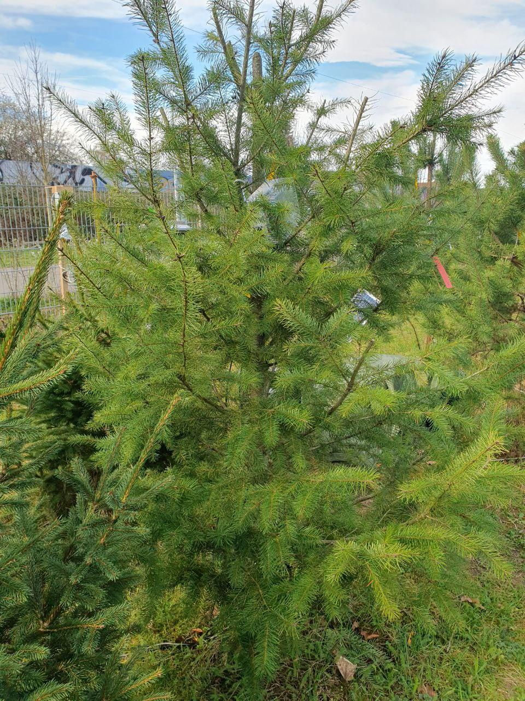
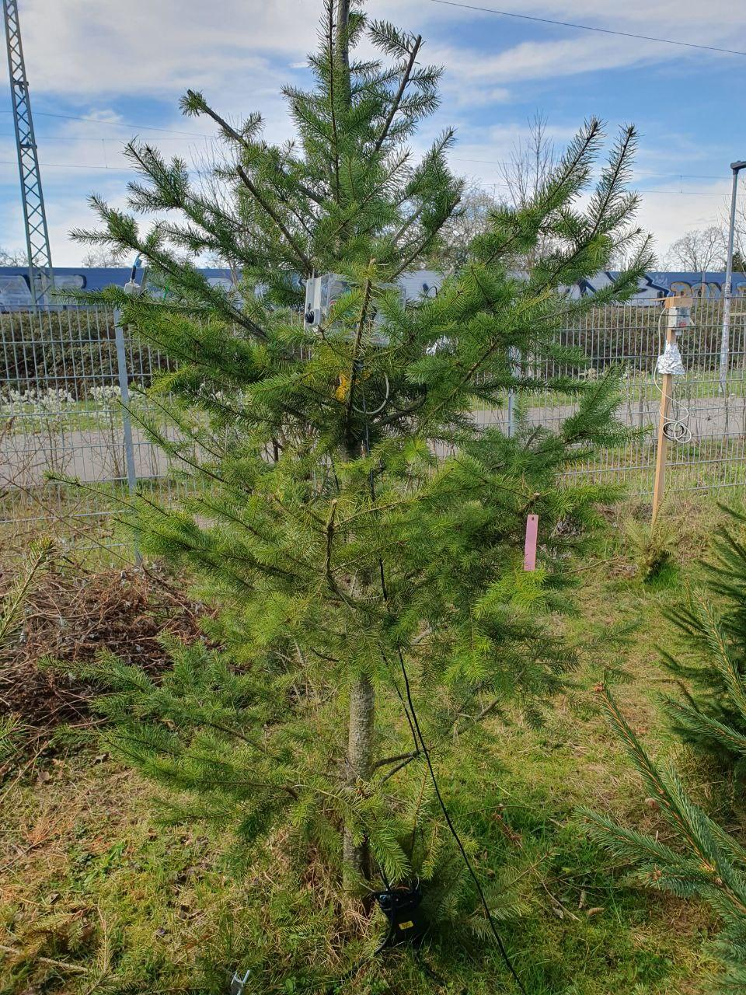
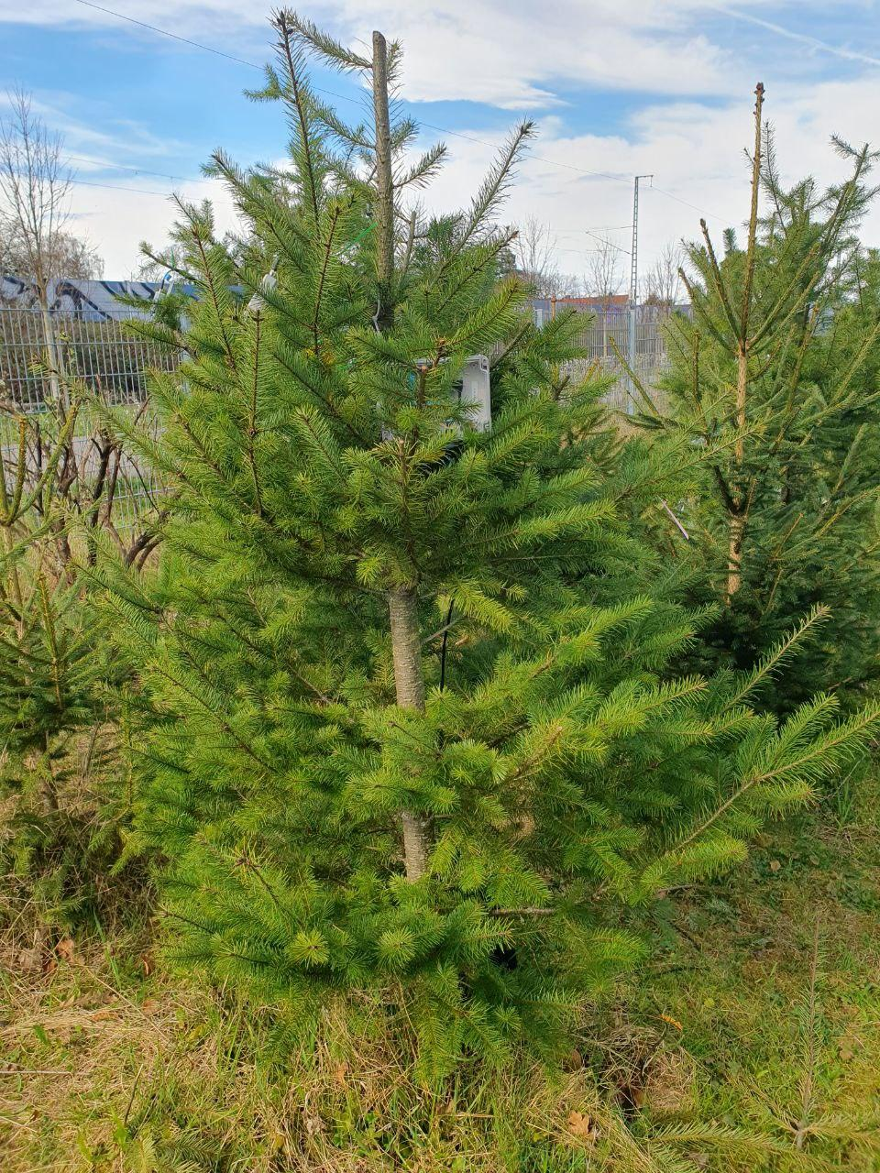
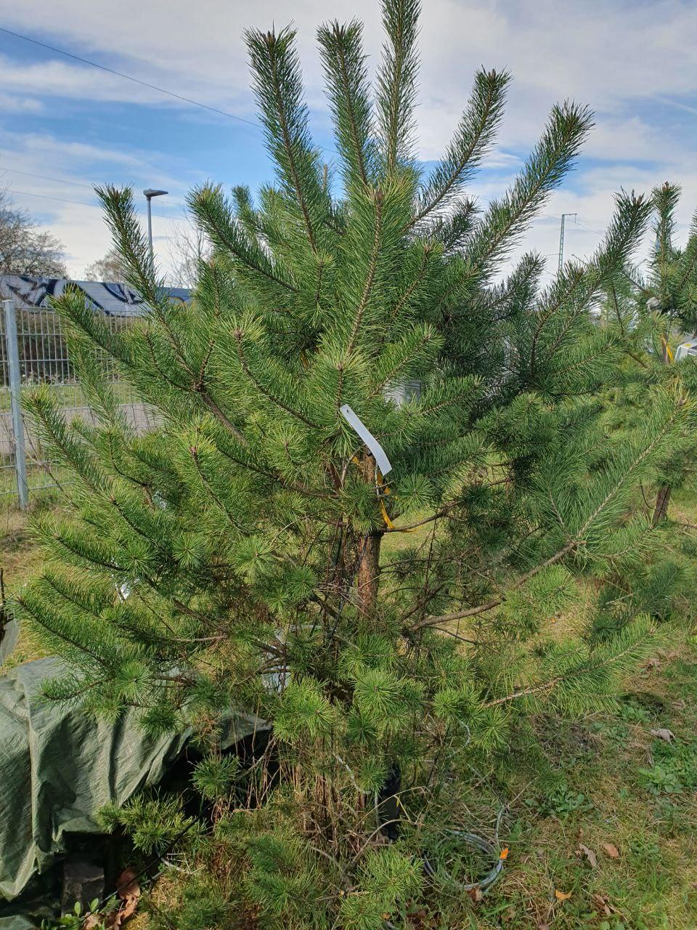
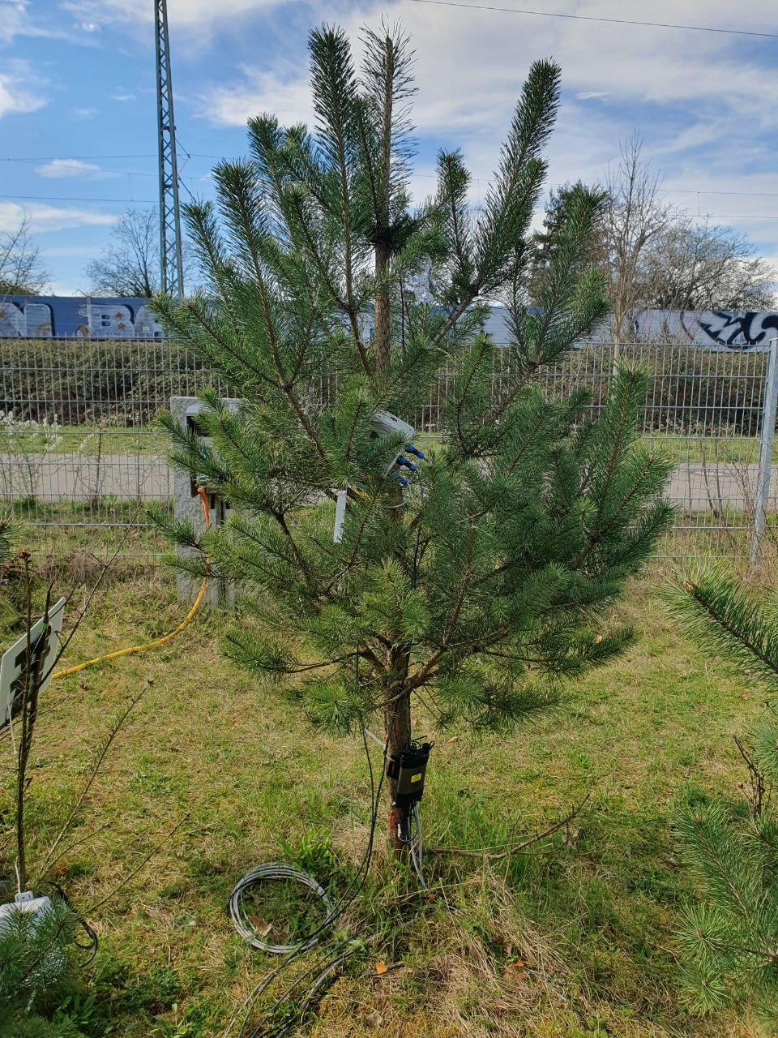
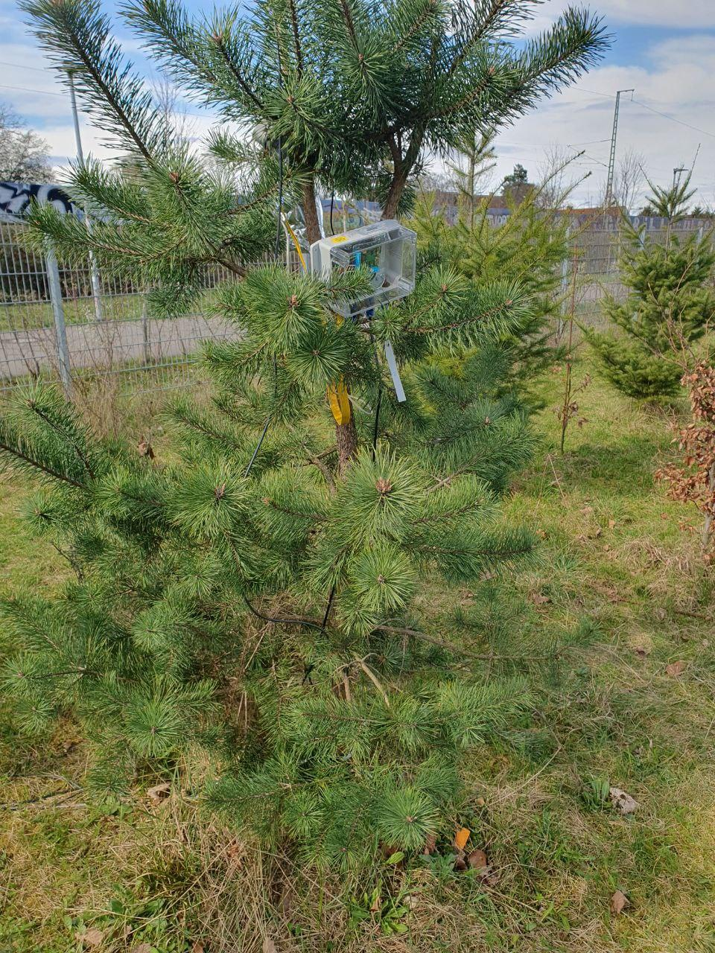
Thanks for your attention!

Slide 33
Hypothesis 2
Partially correct. Sap flow does not align with the results of water potential and isotopic label detection.
Possible explanations
Uncertainties in upscaling of sap flow:
  high radial variation of sap velocity in pine trees
  Scots pine: measured sap flow in outer sap wood much higher than in inner sap wood -> high variation in radial profile of sap flux density in pine trees also found in the literature (Ford et al. 2007)
  Douglas fir: sap flow in inner and outer sap wood similar
  higher weighting of outer sap flow in calculations of total sap flow could have lead to overestimation of sap flow in pine trees

Slide 34
Methods
Water Potential:
on 3 consecutive days, measured with a Scholander pressure bomb
bagging shoot >1h before measurement with aluminium foil, allows equilibration with stem
measurements of 25th of February were excluded due to foggy conditions
Optical dendrometers:
measured continuously, identifying branch area with repeated photographs
used as a proxy for continuous water potential

Slide 35
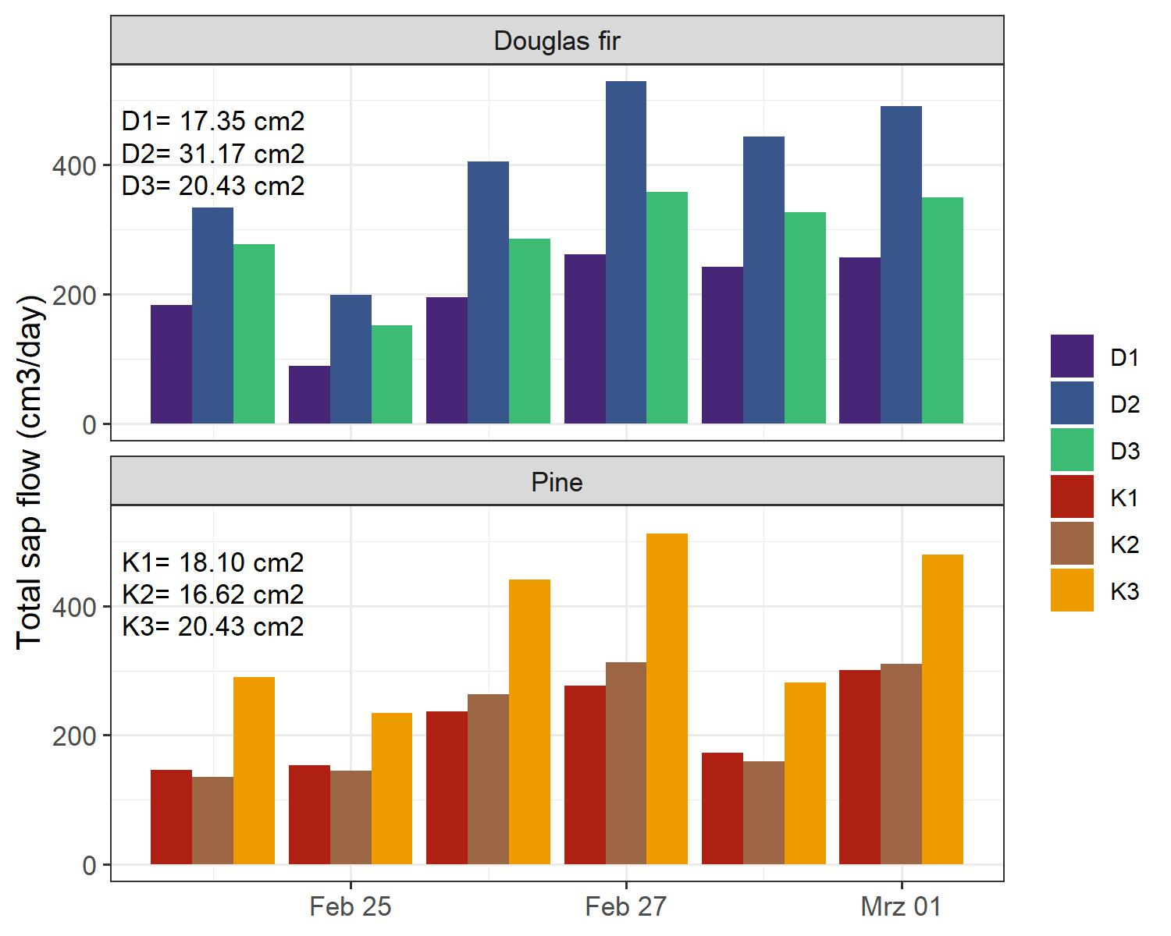
Results
Notes:
D2 larger sap wood area
K3 slightly larger sap wood area than other pine trees
K3 highest difference of outer and inner sap flux density; outer sap flux density much higher, positioning of sap flow sensor in inner and outer sap wood probably high influence on measurements. -> Ford et al. (2004) found variability of sap flux density with depth in xylem of pine trees (pinus spp.) not constant within a day or between trees. Time-dependent changes were sometimes correlated with daily changes in evaporative demand
Douglas fir slightly lower sap flow, but lower water potentials suggesting a higher water flow? and higher label abundunance; -> maybe more water is stored in the sapwood, branches and needles, so they actually transpire more, but use more stored water?
Internally stored water contributed to daily transpiration even in well-watered trees, indicating that stored water plays an important role not only during periods of drought (Zweifel et al. 2001)
Stem sapwood most important storage in old-growth douglas fir trees (Cermák et al. 2007)
Tyree and Yang (1990) concluded that water stored by small trees is mainly capillary water or water released by cavitation and may comprise a large volumn

Slide 36
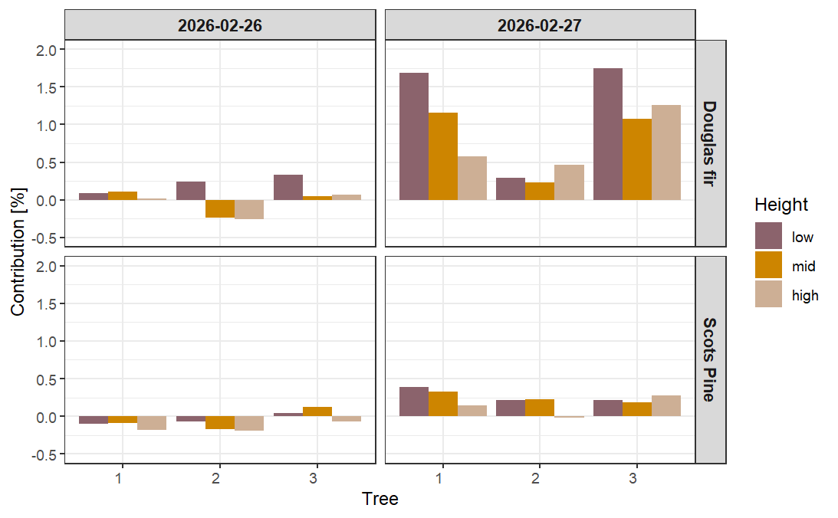
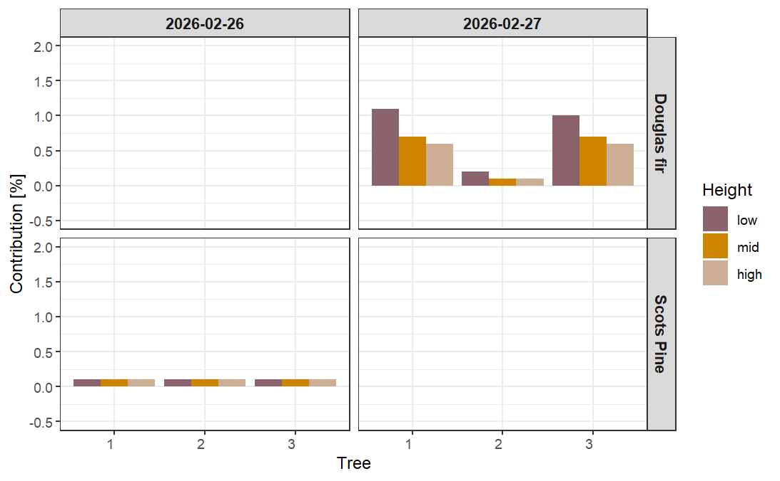
Comparison of the mixing modells
Consistent label detection for 2026-02-27
Mixing Modell Kühnhammer et al.
MixSiar

Slide 37
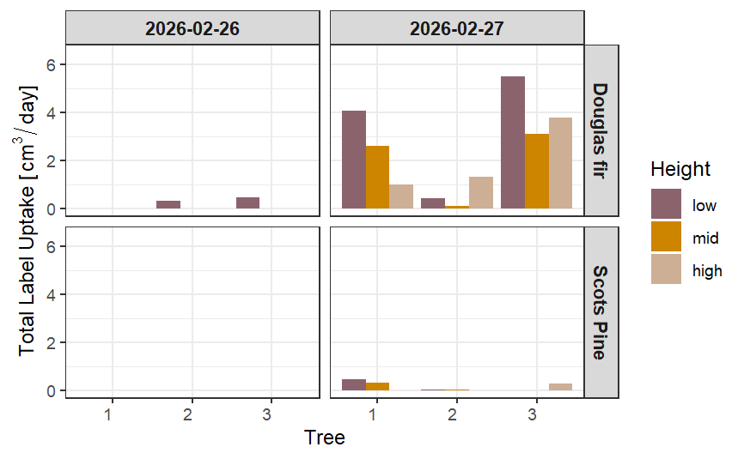
Results - absolute uptake of label
Notes:
ml/day

Slide 38
Results - wrap up
Water potential drops stronger in Douglas fir compared to Scots pine
isotopic signature in douglas fir indicates that label was taken up faster, also transported to upper branches
soil moisture measured next to Douglas fir trees decreased throughout sunny days
however: sap flow indicates comparable water consumption in Douglas fir and Pine

Slide 39
Results - Label contribution Kühnhammer approach

Slide 40
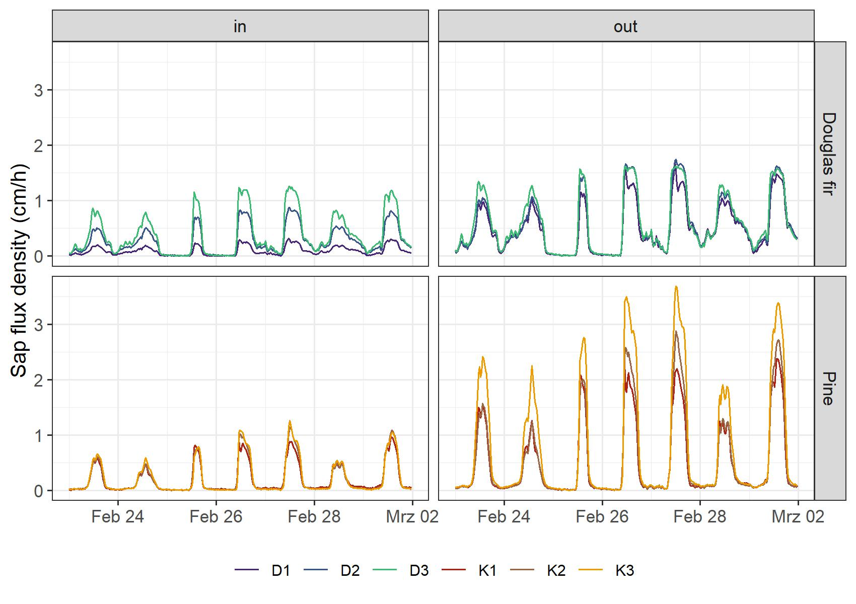
Sap flux density - Radial variation
Notes:
nur 2-5% bei Kiefern ist inner sap flux, Großteil ist outer sap flux, bei Douglasien 2-13%
NADEZHDINA et al.: Overestimation of sap flux density in Pinus sylvestris when measuring in outer xylem

Slide 41
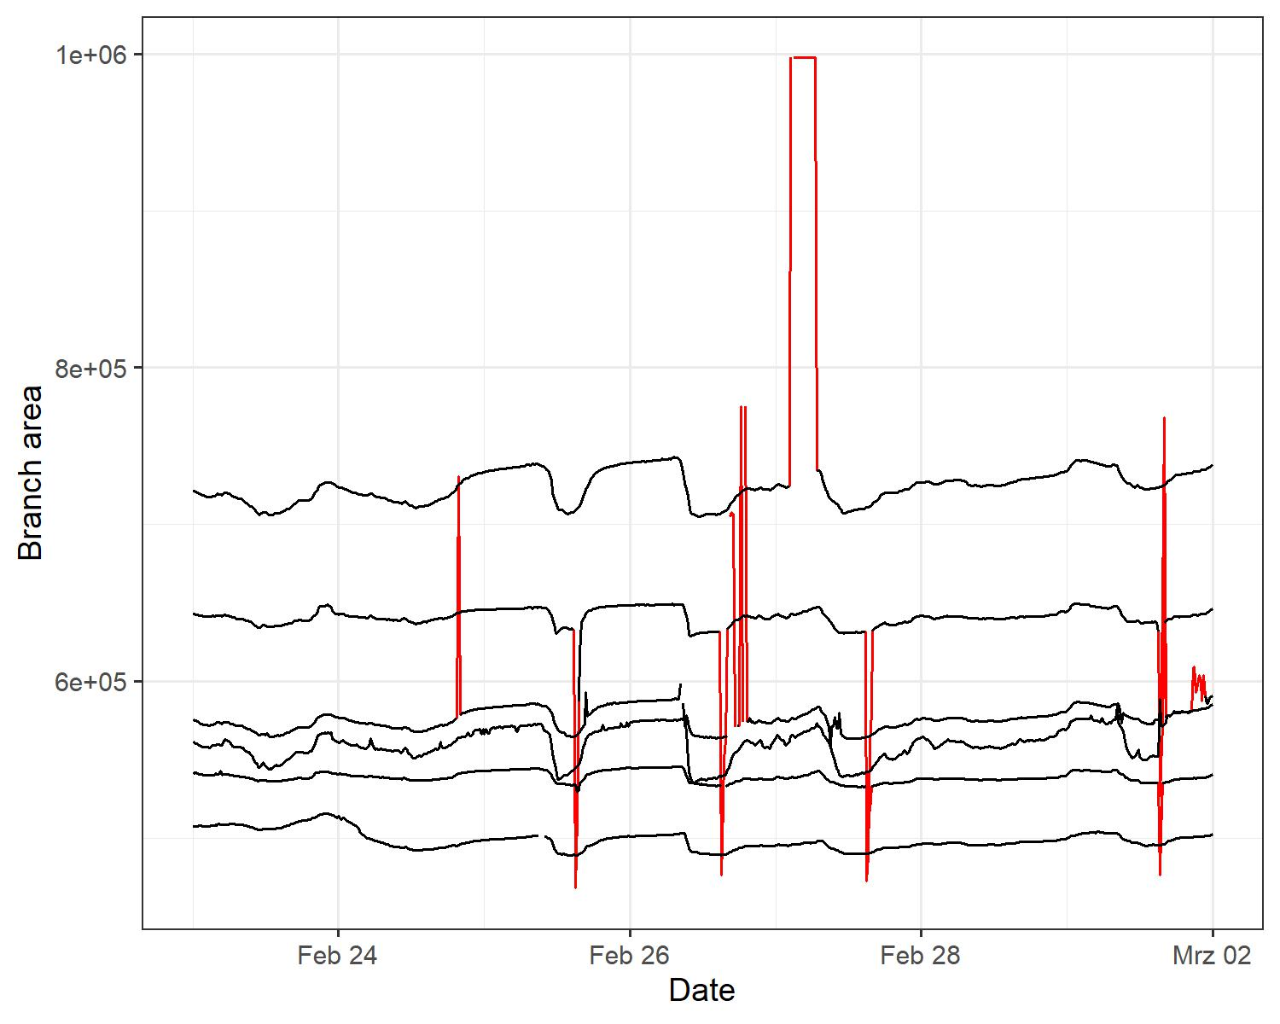
Filter optical dendrometers
mean(timeseries) +-
3* standard deviation

